Slide 1
UNIT-6

Slide 2
Concepts of Applets, differences between applets and Applications
Life cycle of an applet
Types of applets,
creating applets,
passing parameters to applets
Basics of Networking
TCP/IP Sockets
Datagram’s
Simple Client Server program
Multiple clients
Sending file from Server to Client
Parallel search server

Slide 3
What is an applet?
Applet: A small Java program that can be inserted into a web page and
run by loading that page in a browser.
An applet is a special kind of Java program that is designed to be
transmitted over the Internet and automatically executed by a Java-
compatible web browser.
Applets are small applications that are accessed on an Internet server,
transported over the Internet, automatically installed, and run as part of
a web document.

Slide 4
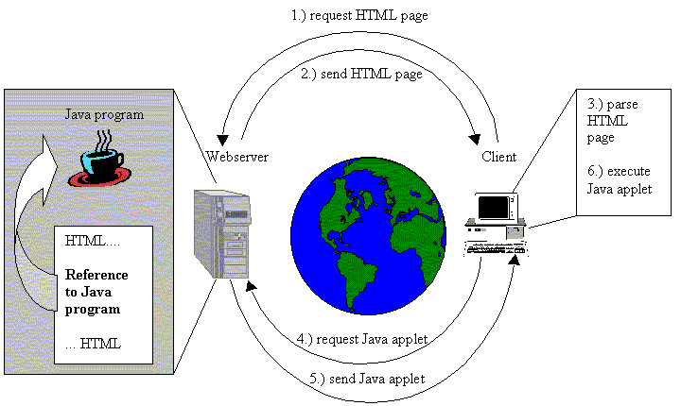

Slide 5
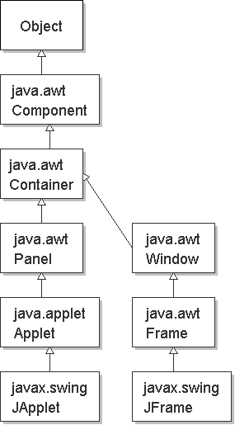
Applet classes in Java
java.lang.Object
java.awt.Component
  java.awt.Container
    java.awt.Panel
      java.applet.Applet
        javax.swing.JApplet

Slide 6
How Applets Differ from Applications
Although both the Applets and stand-alone applications are Java
programs, there are certain restrictions are imposed on Applets due to
security concerns:
  Applets don’t use the main() method, but when they are loaded, automatically call certain methods (init, start, paint, stop, destroy).
  They are embedded inside a web page and executed in browsers.
  Takes input through Graphical User Input ( GUI ).
  They cannot read from or write to the files on local computer.
  They cannot run any programs from the local computer.
The above restrictions ensures that an Applet cannot do any damage to the local system.

Slide 7
Applets can be embedded in HTML pages and downloaded over the Internet whereas Applications have no special support in HTML for embedding or downloading.
Applets can only be executed inside a java compatible web browser or appletviewer whereas Applications are executed at command line by java.
After an applet arrives on the client, it has limited access to resources on local computer. Applications have no restriction to access resources.
Applets don’t have the main() method as in applications. Instead they operate on an entirely different mechanism where they are initialized by init(),started by start(),stopped by stop() or destroyed by destroy().
A Java Applet is made up of at least one public class that has to be subclasses from java.applet.Applet. Whereas, A Java application is made up of a main() method declared as public static void that accepts a string array argument, along with any other classes that main() calls.

Slide 8
Life cycle of an Applet
init()
Born
Begin
stop()
start()
Running
Idle
destroy()
paint()
start()
Dead
End

Slide 9
Life cycle of an Applet
It is important to understand the order in which these methods are called.
When an applet is started , the following sequence of method calls takes place:
  1. init( )
  2. start( )
  3. paint( )
When an applet is terminated, the following sequence of method calls takes place:
1. stop( )
2. destroy( )

Slide 10
Applet States
Initialisation
→ The init( ) method is the first method to be called.
→ This is where you should initialize variables.
→This method is called only once during the run time of your applet.
Running – more than once
→The start( ) method is called after init( ).
→It is also called to restart an applet after it has been stopped.
→It is called each time an applet’s HTML document is displayed on screen.
→So, if a user leaves a web page and comes back, the applet resumes execution at start( ).
Display – more than once
→ paint() happens immediately after the applet enters into the running state.
It is responsible for displaying output.
→ paint( ) is also called when the applet begins execution.
→ The paint( ) method is called each time your applet’s output must be redrawn.
→ The paint( ) method has one parameter of type Graphics.

Slide 11
Idle
→ The stop( ) method is called when a web browser leaves the HTML document containing the applet—when it goes to another page.
Dead/Destroyed State – only once
→ The destroy( ) method is called when the environment determines that your applet needs to be removed completely from memory.
→ At this point, you should free up any resources the applet may be using. The stop( ) method is always called before destroy( ).

Slide 12
Building Applet Code: An Example
import java.awt.*;
import java.applet.Applet;
public class SimpleApplet extends Applet {
public void paint(Graphics g) {
g.drawString (“A Simple Applet",20, 20);
}
}
Begins with two import classes.
  java.awt.* -- required for GUI
  java.applet.* -- every applet you create must be a subclass of Applet, which is in java.applet package.
  The class should start with public, because is accessed from outside.

Slide 13
Contd..
Applets do not begin execution at main().
An applet begins its execution when the name of its class is passed to an applet viewer or to a java compatible browser.
Compile the applet in the same way that we have been compiling programs.
Running an applet involves a different process.

Slide 14
Running an Applet
There are two ways in which you can run an applet:
  Executing the applet within a Java-compatible browser.
  Using a tool called , appletviewer. An applet viewer executes your applet in a window. This is generally the fastest and easiest way to test your applet.

Slide 15
Executing in a web browser.
To execute an applet in a web browser, you need to write a short HTML file that contains a tag ( Applet ) that loads the applet.
HTML file that contains a SimpleApplet
<APPLET code=“SimpleApplet“ width=400 height=300>
</APPLET>
Save the file with .html extension (Example: Simple.html)
After you create this file, open your browser and then load this file, which causes SimpleApplet to be executed.
width and height specify the dimensions of the display used by the applet.

Slide 16
Executing by using appletviewer
There are two ways
1. Use earlier html page, which contains applet tag, then execute by using following command.
  C:\>appletviewer htmlfilename.html
  2. Include a comment at the beginning of your source code file that
  contains the applet tag, then start applet viewer with your java source
  code file. C:\>appletviewer SimpleApplet.java
import java.awt.*;
import java.applet.Applet;
/* <applet code=“SimpleApplet” width=200 height=60 ></applet> */
public class SimpleApplet extends Applet {
public void paint(Graphics g) {
g.drawString (“A Simple Applet",20, 20);
}
}

Slide 17
Four of these methods init(), start(), stop(), and destroy() are defined by Applet.
Another, paint() is defined by the AWT Component class.
Although the above program does not do anything, it can be compiled and run.

Slide 18
Structure of an applet
// An Applet AppletStructure
import java.awt.*;
import java.applet.*;
/* <applet code="AppletStructure" width=300 height=100> </applet> */
public class AppletStructure extends Applet {
// Called first.
public void init() {
// initialization
}
/* Called second, after init(). Also called whenever the applet is restarted. */
public void start() {
// start or resume execution
}
// Called when the applet is stopped.
public void stop() {
// suspends execution
}
/* Called when applet is terminated. This is the last method executed. */
public void destroy() {
// perform shutdown activities
}
// Called whenever an applet's output must be redisplayed.
public void paint(Graphics g) {
// redisplay contents of window
}
}

Slide 19
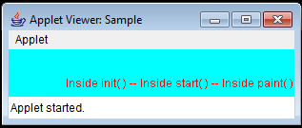
Creating Applets
/* A simple applet that sets the foreground and background colors and outputs a string. */
import java.awt.*;
import java.applet.*;
/* <applet code="Sample" width=300 height=50> </applet> */
public class Sample extends Applet{
String msg;
public void init() { // set the foreground and background colors.
setBackground(Color.cyan);
setForeground(Color.red);
msg = "Inside init( ) --";
}
public void start() { // Initialize the string to be displayed.
msg += " Inside start( ) --";
}
public void paint(Graphics g) { // Display msg in applet window.
msg += " Inside paint( ).";
g.drawString(msg, 60, 40);
}
}

Slide 20
Passing Parameters to Applet
The APPLET tag in HTML allows you to pass parameters to your applet.
To retrieve a parameter, use the getParameter( ) method.
It returns the value of the specified parameter in the form of a String object.

Slide 21
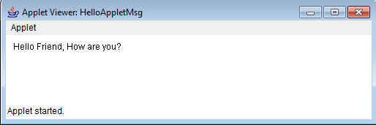
Applet Program Accepting Parameters
import java.applet.Applet;
import java.awt.*;
/* <APPLET CODE="HelloAppletMsg" width=500 height=400>
<PARAM NAME="Greetings" VALUE="Hello Friend, How are you?">
</APPLET> */
public class HelloAppletMsg extends Applet {
String msg;
public void init(){
msg = getParameter("Greetings");
if( msg == null)
msg = "Hello";
}
public void paint(Graphics g) {
g.drawString (msg,10, 100);
}
}
This is name of parameter specified in PARAM tag;
This method returns the value of paramter.

Slide 22
Types of applets
There are two types of applets:
First is based on the Applet class
→ These applets use the AWT to provide the GUI.
→ This style of applet has been available since java was created.
→ It is used for simple GUI’s.
The second is based on the Swing class JApplet.
→ These applets use the Swing classes to provide the GUI.
→ Swing offers a richer and easy to use interface than AWT .
→ Swing based applets are more popular.

Slide 23
Handling Mouse Events using Applets
// Demonstrate the mouse event handlers.
import java.awt.*;
import java.awt.event.*;
import java.applet.*;
/* <applet code="MouseEvents" width=300 height=100>
</applet>*/
public class MouseEvents extends Applet implements MouseListener, MouseMotionListener {
String msg = "";
int mouseX = 0, mouseY = 0; // coordinates of mouse
public void init() {
addMouseListener(this);
addMouseMotionListener(this);
}

Slide 24
// Handle mouse clicked.
public void mouseClicked(MouseEvent me) {
// save coordinates
mouseX = 0;
mouseY = 10;
msg = "Mouse clicked.";
repaint();
}
// Handle mouse entered.
public void mouseEntered(MouseEvent me) {
// save coordinates
mouseX = 0;
mouseY = 10;
msg = "Mouse entered.";
repaint();
}
// Handle mouse exited.
public void mouseExited(MouseEvent me) {
// save coordinates
mouseX = 0;
mouseY = 10;
msg = "Mouse exited.";
repaint();
}

Slide 25
// Handle button pressed.
public void mousePressed(MouseEvent me) {
// save coordinates
mouseX = me.getX();
mouseY = me.getY();
msg = "Down";
repaint();
}
// Handle button released.
public void mouseReleased(MouseEvent me) {
// save coordinates
mouseX = me.getX();
mouseY = me.getY();
msg = "Up";
repaint();
}
// Handle mouse dragged.
public void mouseDragged(MouseEvent me) {
// save coordinates
mouseX = me.getX();
mouseY = me.getY();
msg = "*";
showStatus("Dragging mouse at " + mouseX + ", " + mouseY);
repaint();
}

Slide 26
// Handle mouse moved.
public void mouseMoved(MouseEvent me) {
// show status
showStatus("Moving mouse at " + me.getX() + ", " + me.getY());
}
// Display msg in applet window at current X,Y location.
public void paint(Graphics g) {
g.drawString(msg, mouseX, mouseY);
}
}

Slide 27
/*Week 6 : b) Develop an applet that receives an integer in one text field, and computes its factorial Value and returns it in another text field, when the button named “Compute” is clicked. */

Slide 28
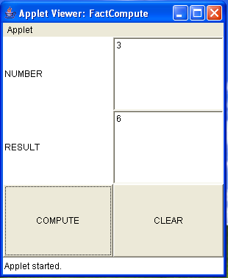
import java.applet.*;
import java.awt.*;
import java.awt.event.*;
/*<applet code=FactCompute width=300 height=300>
</applet>*/
public class FactCompute extends Applet
implements ActionListener{
Button btn,clearbtn;
Label lbl1,lbl2;
TextField tf1,tf2;
public void init() {
btn=new Button("COMPUTE");
btn.addActionListener(this);
clearbtn=new Button("CLEAR");
clearbtn.addActionListener(this);
tf1=new TextField(30);
tf2=new TextField(30);
lbl1=new Label("NUMBER");
lbl2=new Label("RESULT");
setLayout(new GridLayout(3,2));
add(lbl1); add(tf1);
add(lbl2); add(tf2);
add(btn); add(clearbtn);
}

Slide 29
public void actionPerformed(ActionEvent e)
{
if(e.getSource()==btn)
{
int a=Integer.parseInt(tf1.getText());
int fact=1;
for(int i=1;i<=a;i++)
fact*=i;
tf2.setText(""+fact);
}
else
{
tf1.setText("");
tf2.setText("");
}
}
}

Slide 30
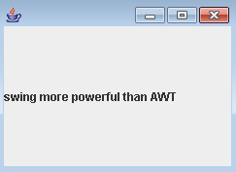
Simple Swing Application
import java.awt.*;
import javax.swing.*;
/*<applet code="myjframe2.class" width=100 height=200></applet>*/
public class myjframe2 extends JApplet{
public void init(){
JLabel jl=new JLabel("swing more powerful than AWT");
add(jl);
}
}

Slide 31
The methods defined by Applet
String getParameter(String paramName)
Returns the parameter associated with paramName. null is returned if the specified parameter is not found.
void showStatus(String str)
Displays str in the status window of the browser or applet viewer. If the browser does not support a status window, then no action takes place.
URL getCodeBase( )
Returns the URL associated with the invoking applet.
URL getDocumentBase( )
Returns the URL of the HTML document that invokes the applet.

Slide 32
The HTML APPLET Tag
The syntax for the standard APPLET tag is shown here. Bracketed items
are optional.
< APPLET
[CODEBASE = codebaseURL]
CODE = appletFile
[ALT = alternateText]
[NAME = appletInstanceName]
WIDTH = pixels HEIGHT = pixels
[ALIGN = alignment]
[VSPACE = pixels] [HSPACE = pixels]
>
[< PARAM NAME = AttributeName VALUE = AttributeValue>]
[< PARAM NAME = AttributeName2 VALUE = AttributeValue>]
. . .
[HTML Displayed in the absence of Java]
</APPLET>

Slide 33
void setBackground(Color newColor)
void setForeground(Color newColor)
Here, newColor specifies the new color. The class Color defines the constants
shown here that can be used to specify colors:
Color.black Color.magenta Color.blue Color.orange
Color.cyan Color.pink Color.darkGray Color.red
Color.gray Color.white Color.green Color.yellow
Color.lightGray
For example, this sets the background color to green and the text color to red:
setBackground(Color.green); setForeground(Color.red);
A good place to set the foreground and background colors is in the init( ) method.
You can obtain the current settings for the background and foreground colors by
calling getBackground( ) and getForeground( ), respectively. They are also
defined by Component and are shown here:
Color getBackground( ) Color getForeground( )

Slide 34
AudioClip getAudioClip(URL url, String clipName)
Returns an AudioClip object that encapsulates the audio clip found
at the location specified by url and having the name specified by
clipName.
Image getImage(URL url,String imageName)
Returns an Image object that encapsulates the image found at the
location specified by url and having the name specified by imageName.
void play(URL url, String clipName)
If an audio clip is found at the location specified by url with the name
specified by clipName, the clip is played.

Slide 35
Basics of Networking
The term network programming refers to writing programs that execute across multiple devices (computers), in which the devices are all connected to each other using a network.
The java.net package contains a collection of classes and interfaces which are used to implement programs to communicate across network.
The java.net provides support for the two common network protocols:
  TCP: Transmission Control Protocol, which allows for reliable communication between two applications. TCP is typically used over the Internet Protocol, which is referred to as TCP/IP.
  UDP: User Datagram Protocol, a connection-less protocol that allows for packets of data to be transmitted between applications.

Slide 36
Contd…
IP Address (Internet Protocol Address )
It is an unique identifier which is assigned to device (computer) to identify itself and communicate with other devices in the Internet Protocol network.
Networks using the TCP/IP protocol route messages based on the IP address of the destination.
The format of an IP address is a 32-bit numeric address written as four numbers separated by periods.
Each number can be 0 to 255.
For example: 1.160.10.240 could be an IP address.
Otherwise, IP Address is used to identify host.
Notes:
We need some way to identify computers on an internetwork
The “dotted-quad” representation is just a more readable version of a real 32-bit number

Slide 37

Port
Generally a host has many applications.
Port is used to identify the specific application .
It is a 16-bit identifier.
A port represents an endpoint for network communications.
Port numbers allow different applications on the same computer to utilize network resources without interfering with each other.
Application WWW E-mail Telnet
Port 80 25 23
192.18.22.13
Notes:
Ports are analogous to phone extensions from main switchboard

Slide 38
Socket
A socket represents a single connection between two network applications. It is an object used for network programming.
Sockets are bidirectional, meaning that either side of the connection is capable of both sending and receiving data.
A socket is bound to a specific port number.
Network communication using Sockets is very much similar to performing file I/O.
The streams used in file I/O operation are also applicable to socket-based I/O.

Slide 39
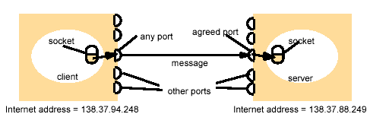

Slide 40
The following steps occur when establishing a TCP connection
between two computers using sockets:
The server instantiates a ServerSocket object, denoting which port number communication is to occur on. That is it provides a mechanism for the server program to listen for clients and establish connections with them.
The server invokes the accept() method of the ServerSocket class. This method waits until a client connects to the server on the given port.
After the server is waiting, a client instantiates a Socket object, specifying the server name and port number to connect to.

Slide 41
The constructor of the Socket class attempts to connect the client to the specified server and port number. If communication is established, the client now has a Socket object capable of communicating with the server.
On the server side, the accept() method returns a reference to a new socket on the server that is connected to the client's socket.
After the connections are established, communication can occur using I/O streams. Each socket has both an OutputStream and an InputStream. The client's OutputStream is connected to the server's InputStream, and the client's InputStream is connected to the server's OutputStream.
TCP is a two way communication protocol, so data can be sent across both streams at the same time.

Slide 42
Classes used to create communication between client and server:
The java.net.ServerSocket class is used by server applications to obtain a port and listen for client requests.
It is used to implement Server.
The java.net.Socket class represents the socket that both the client and server use to communicate with each other.
It is used to implement Client.
The client obtains a Socket object by instantiating one, whereas the server obtains a Socket object from the return value of the accept() method.

Slide 43
ServerSocket Constructors
public ServerSocket() throws IOException
Creates an unbound server socket. When using this constructor, use the bind() method when you are ready to bind the server socket.
public ServerSocket(int port) throws IOException
Attempts to create a server socket bound to the specified port. An exception occurs if the port is already bound by another application.

Slide 44
ServerSocket Methods
public int getLocalPort()
Returns the port that the server socket is listening on.
public Socket accept() throws IOException
Waits for an incoming client. This method blocks until either a client connects to the server on the specified port or the socket times out.
public void bind(SocketAddress host, int port)
Binds the socket to the specified server and port in the SocketAddress object. Use this method if you instantiated the ServerSocket using the no-argument constructor.

Slide 45
Socket Constructors
public Socket()
Creates an unconnected socket. Use the connect() method to connect this socket to a server.
public Socket(String host, int port) throws UnknownHostException, IOException.
It attempts to connect to the specified server at the specified port.
If this constructor does not throw an exception, the connection is successful and the client is connected to the server.

Slide 46
Socket Methods
public void connect(SocketAddress host, int port) throws IOException
It connects the socket to the specified host. This method is needed only when you instantiated the Socket using the no-argument constructor.
public InputStream getInputStream() throws IOException
Returns the input stream of the socket. The input stream is connected to the output stream of the remote socket.
public OutputStream getOutputStream() throws IOException
Returns the output stream of the socket. The output stream is connected to the input stream of the remote socket.
public void close() throws IOException
Closes the socket, which makes this Socket object no longer capable of connecting again to any server.

Slide 47
Client-Server Communication
Server
Client
socket()
bind()
listen()
socket()
accept()
establish
connection
connect()
block
send request
write()
read()
process
request
send response
write()
read()

Slide 48
Implementing a Server
1. Open the Server Socket:
ServerSocket server;
DataOutputStream dos;
DataInputStream dis;
server = new ServerSocket( PORT );
2. Wait for the Client Request:
Socket s = server.accept();
3. Create I/O streams for communicating to the client
dis = new DataInputStream( s.getInputStream() );
dos = new DataOutputStream( s.getOutputStream() );
4. Perform communication with client
Receive from client: String line = dis.readLine();
Send to client: dos.write ("Hello\n");
5. Close Connections: client.close(); dos.close(); dis.close(); s.close();

Slide 49
Implementing a Client
1. Create a Socket Object:
Socket client;
DataOutputStream dos;
DataInputStream dis;
client = new Socket( serveradd, portnumber );
2. Create I/O streams for communicating with the server.
dis = new DataInputStream(client.getInputStream() );
dos = new DataOutputStream( client.getOutputStream() );
3. Perform I/O or communication with the server:
  Receive data from the server: String line = dis.readLine();
  Send data to the server: dos.write ("Hello\n");
4. Close the socket when done:
client.close(); dos.close(); dis.close();

Slide 50
import java.io.*; import java.net.*;
class Server{
public static void main(String args[])throws Exception{
ServerSocket ss=new ServerSocket(1212);
Socket s=ss.accept();
System.out.println("Connection Established\n");
DataOutputStream dos=new DataOutputStream(s.getOutputStream());
DataInputStream dis=new DataInputStream(s.getInputStream());
DataInputStream kb=new DataInputStream(System.in);
while(true){
String str,str1;
while((str=dis.readLine())!=null){
System.out.println(str);
str1=kb.readLine();
dos.writeUTF(str1);
}
dos.close(); dis.close();
kb.close(); ss.close();
s.close(); System.exit(0);
}
}
}

Slide 51
import java.io.*;
import java.net.*;
class Client{
public static void main(String args[])throws Exception{
Socket s=new Socket("localhost",1212);
DataOutputStream dos=new DataOutputStream(s.getOutputStream());
DataInputStream dis=new DataInputStream(s.getInputStream());
DataInputStream kb=new DataInputStream(System.in);
String str,str1;
while(!(str=kb.readLine()).equals("exit")){
dos.writeBytes(str+"\n");
str1=dis.readUTF();
System.out.println(str1);
}
dos.close();
dis.close();
kb.close();
s.close();
}
}

Slide 52
Multiple clients
Multiple clients can connect to the same port on the server at the same time.
That is more than one client can communicate with the same server at the same time.

Slide 53
import java.net.*; //Server Program
public class ServerHandler {
static ServerSocket socket; static int port = 7999;
public static void main(String[] args) {
try {
socket = new ServerSocket(port);
System.out.println("Bound to port: " + port);
} catch (Exception e) {
System.out.println("Cannot bind to port: " + port);
System.exit(0);
}
while (true) {
try {
Socket s = socket.accept();
System.out.println("New Client: "+s.getInetAddress().toString());
(new Thread(new ClientHandler(s))).start();
} catch (Exception e) {
System.out.println("Failed to accept client");
}
}
}
}

Slide 54
import java.net.*; //Client Program
public class ClientHandler implements Runnable {
Socket socket;
ClientHandler(Socket s) {
socket = s;
}
public void run(){
try {
socket.close();
}
catch (Exception e) {
System.out.println("Failed to close, oddly...");
}
}
public static void main(String args[])throws Exception{
Socket s=new Socket("localhost",7999);
new ClientHandler(s);
}
}

Slide 55
Sending file from Server to Client
import java.io.*; import java.net.*;
class FTServer{
public static void main(String args[])throws Exception{
ServerSocket ss=new ServerSocket(2424);
Socket s=ss.accept();
System.out.println("Connection Established\n");
File myFile = new File ("e:\\server.java");
FileInputStream fis = new FileInputStream(myFile);
DataInputStream dis=new DataInputStream(fis);
byte [] mybytearray = new byte [(int)myFile.length()];
dis.read(mybytearray,0,mybytearray.length);
DataOutputStream dos=new DataOutputStream(s.getOutputStream());
dos.write(mybytearray,0,mybytearray.length);
System.out.println("File has been sent successfully...");
s.close(); ss.close(); dos.close();
fis.close(); dis.close(); System.exit(0);
}
}

Slide 56
import java.io.*; import java.net.*;
class FRClient{
public static void main(String args[])throws Exception{
Socket s=new Socket("localhost",2424);
System.out.println("waiting for File from Server.....");
DataInputStream dis=new DataInputStream(s.getInputStream());
String str;
boolean b=true;
while(b){
str=dis.readLine();
if(str==null)
b=false;
else
System.out.println(str);
}
dis.close();
s.close();
}
}

Slide 57
Datagram
TCP/IP style networking provides a serialized, predictable, reliable stream of packet data transfer.
Datagrams are bundles of information passed between machines.
Once the datagram has been released to its intended target, there is no
assurance that it will arrive or even that someone will be there to catch it.
Java implements datagrams on top of the UDP protocol by using two
classes:
→DatagramPacket object is the data container,
→DatagramSocket is the mechanism used to send or receive the DatagramPackets.

Slide 58
DatagramPacket constructors:
The first constructor specifies a buffer that will receive data, and the size of a
packet. It is used for receiving data over a DatagramSocket.
DatagramPacket(byte data[ ], int size)
The second form allows you to specify an offset into the buffer at which data will be stored.
DatagramPacket(byte data[ ], int offset, int size)
The third form specifies a target address and port, which are used by a
DatagramSocket to determine where the data in the packet will be sent.
DatagramPacket(byte data[ ], int size, InetAddress ipAddress, int port)
The fourth form transmits packets beginning at the specified offset into the data. DatagramPacket(byte data[ ], int offset, int size, InetAddress ipAddress, int port)

Slide 59
There are several methods for accessing the internal state of a DatagramPacket.
They give complete access to the destination address and port number of a packet, as
well as the raw data and its length. Here are some of the most commonly used:
InetAddress getAddress( ) Returns the destination InetAddress, typically used for
sending.
int getPort( ) Returns the port number.
byte[ ] getData( ) Returns the byte array of data contained in the datagram. Mostly used to
retrieve data from the datagram after it has been received.
int getLength( ) Returns the length of the valid data contained in the byte array that would
be returned from the getData( ) method. This typically does not equal the length of the
whole byte array.

Slide 60
import java.net.*;
class WriteServer {
public static int serverPort = 998;
public static int clientPort = 999;
public static int buffer_size = 1024;
public static DatagramSocket ds;
public static byte buffer[] = new byte[buffer_size];
public static void TheServer() throws Exception {
int pos=0;
while (true) {
int c = System.in.read();
switch (c) {
case -1: System.out.println("Server Quits.");
return;
case '\r': break;
case '\n':
ds.send(new DatagramPacket(buffer,pos,InetAddress.getLocalHost(),clientPort));
pos=0;
break;
default:
buffer[pos++] = (byte) c;
}
}
}

Slide 61
public static void TheClient() throws Exception {
while(true) {
DatagramPacket p = new DatagramPacket(buffer, buffer.length);
ds.receive(p);
System.out.println(new String(p.getData(), 0, p.getLength()));
}
}
public static void main(String args[]) throws Exception {
if(args.length == 1) {
ds = new DatagramSocket(serverPort);
TheServer();
} else {
ds = new DatagramSocket(clientPort);
TheClient();
}
}
}

Slide 62
Parallel Search Server
Make your search of the internet easier by using a parallel search engine instead of an individual search engine.
A parallel search engine searches multiple search engines simultaneously and returns the results in one list.

